Slide 1
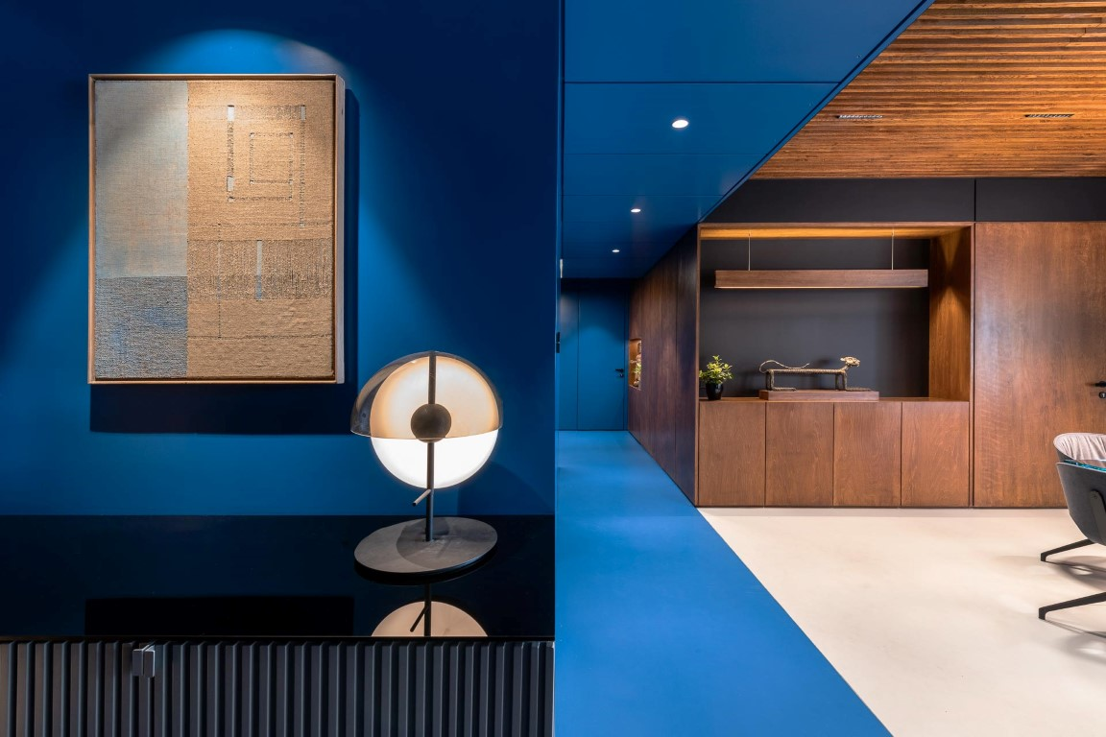
Code 1200

Slide 2
INTRODUCTION
The intent of this design was to work within the context of the Indian cultural narrative with a new language of interpretation that allows for a dynamic, varied and yet enduring experience for the end user.
The spine of the design is the exuberant use of colors, which is a key element of the Indian culture. The subtle yet definitive use of colors to connect with the space without being overwhelming and out of sync presented a new challenge. The mainstay of the theory is the large volume that starts right from the entrance spanning till the lobby for individual rooms. The design intent for it was achieved by having all the surfaces connected to this volume in a single tone of color blue .This move creates an illusion of a chunk of mass being subtracted and separated from the overall volume. Keeping the spaces muted around this scoop further ensures that there is emphasis on this space being the mainstay of design.
Another example of an inspired use of color is how the color black is used in this space. Black, which is typically considered taboo, if used wisely can offer a new interpretation of other colours and elements around it. In this project, the colour black provides a contrast and context to the other colours.
We have attempted to continue the Indian cultural narrative by using local raw materials. The textures of these individual raw elements, such as brick and stone were highlighted using available natural light. The material palate consists of Godhra brick tiles, concrete floor and stained Birch plywood in its raw form. At the same time there are elements like colored PU, back painted glass and matte black paint that balance out the rusticity.
The intent has been to provide an ‘experience’ to the end user that is unpredictable and dynamic. Creating such an experience surely involves risk-taking for the designers, but the reward is an unprecedented yet a enduring experience for the clients.

Slide 3
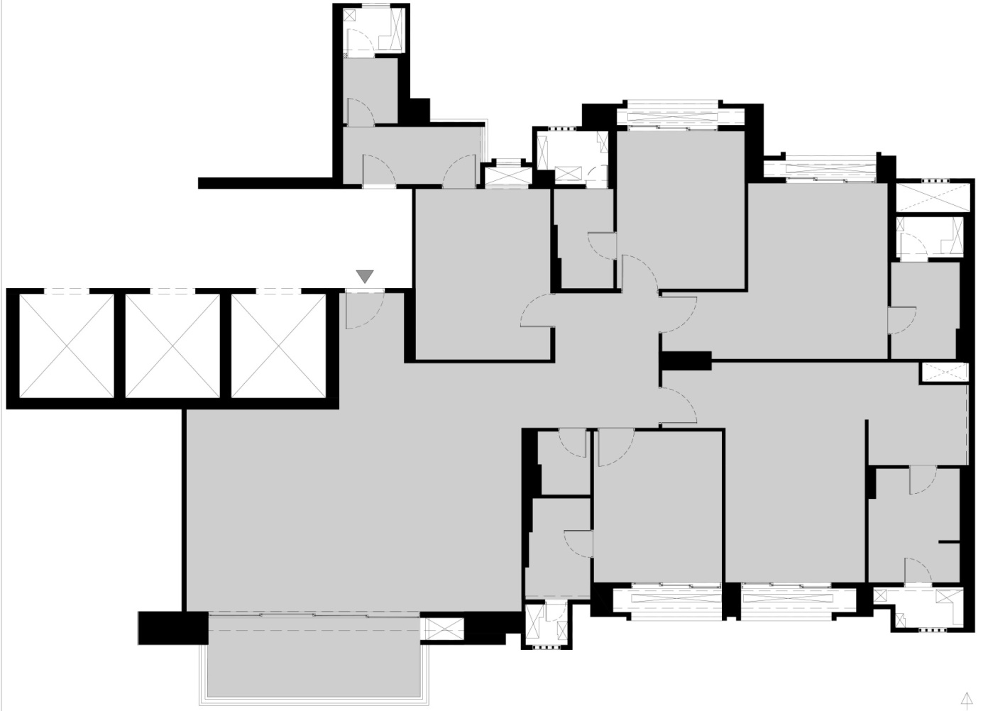
EXISTING LAYOUT
Walls demolished

Slide 4
PROPOSED LAYOUT

Slide 5
ARTWORK & SCULPTURES

Slide 6
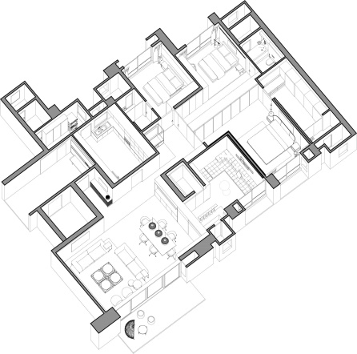
SECTIONS
C
D
B
C’
A
B’
D’

Slide 7
Section A-A’ Through Living area, The scoop, Master bedroom
A’
Section B-B’ Through Lounge, Dining and living area
B
A
B’

Slide 8
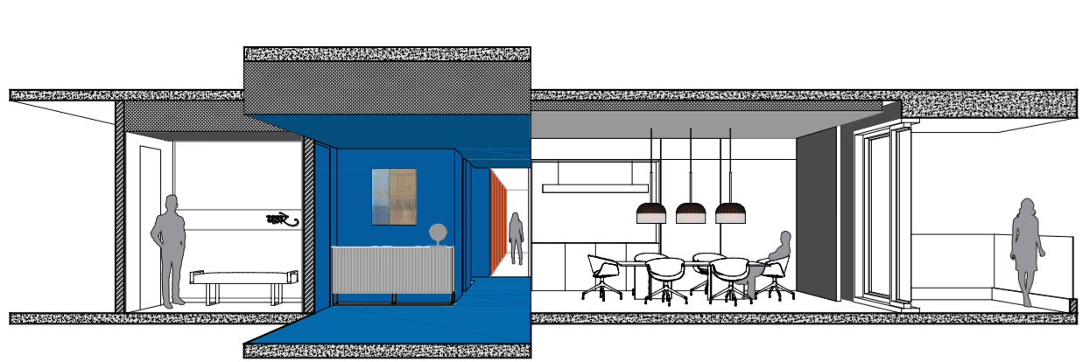
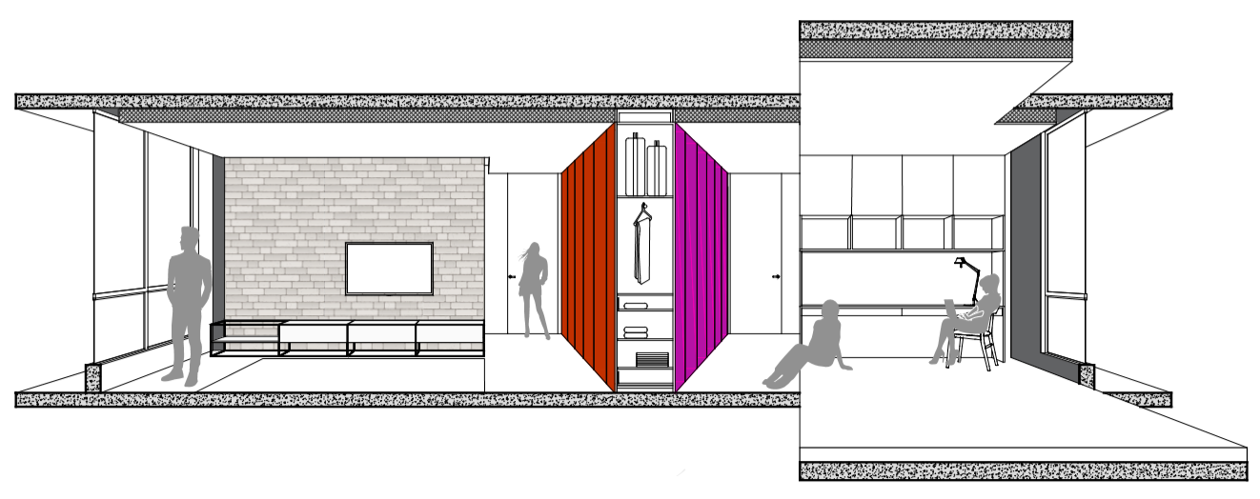
Section D-D’ Through Entrance and foyer, Dining area, Balcony
C
D
Section C-C’ Through Master bedroom and Daughters bedroom
C’
D’

Slide 9
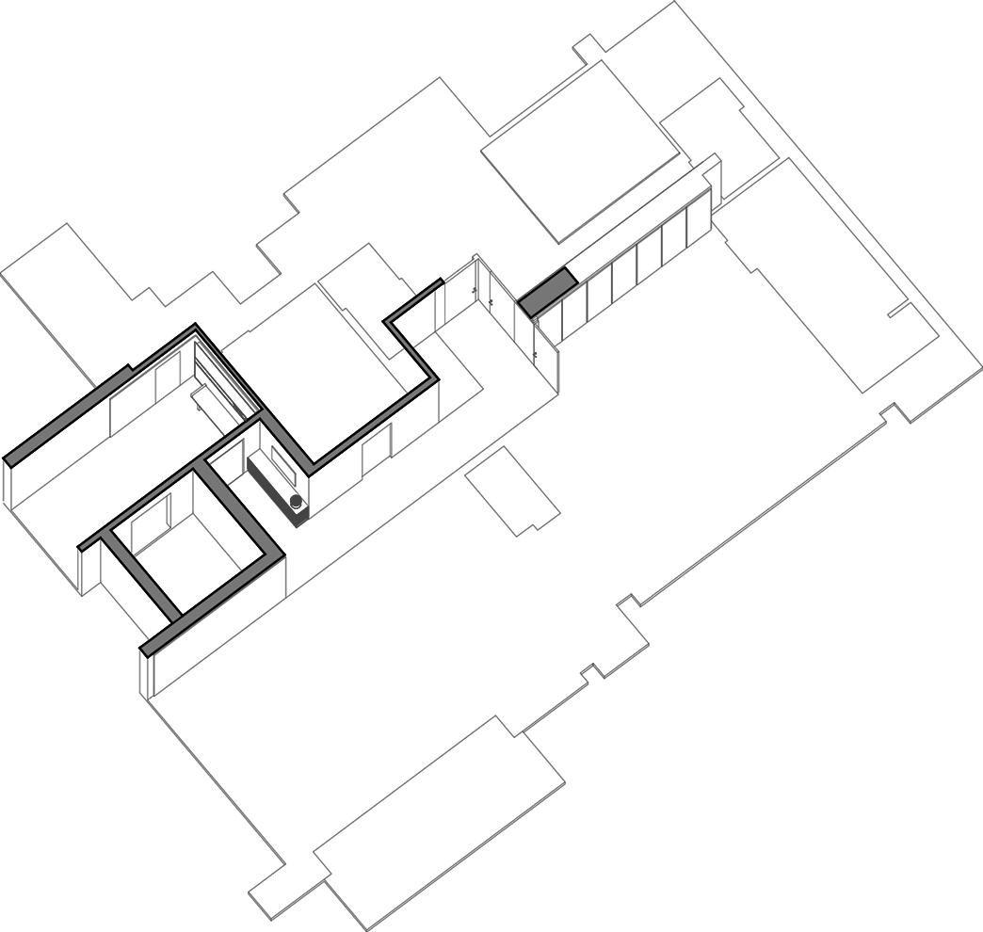
ENTRANCE

Slide 10
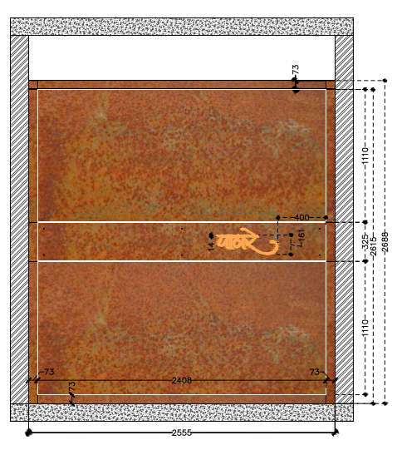
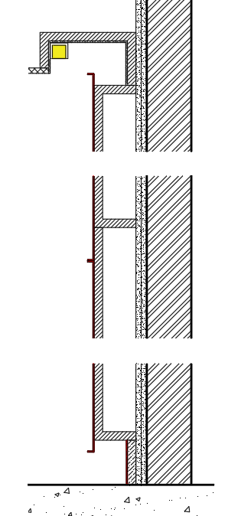
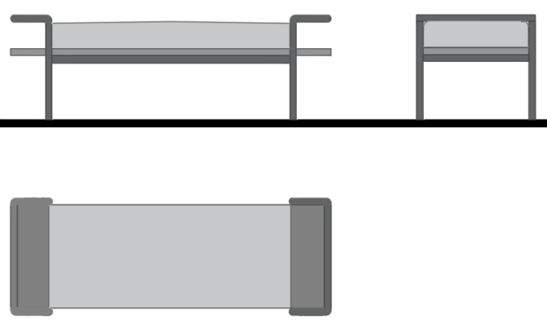
Entrance:
Entrance of the apartment sets the tone for the a modern yet an Indian contemporary design. The Rustic corten steel panel at the entrance is beautifully accentuated by the light falling on it from the top. The entrance is adorned with a rustic seating and Exclusive artefacts which make the entry to the house grand yet bespoke. The raw nature of the rusted corten steel is brought to notice by the wall washer light that grazes the surface of the panel. Right next to this panel sits a bench designed in post modern era. Laser cut backlit suspended letters form the name plate within the corten steel panel.
Gypsum ceiling
3mm corten sheet
Name laser cut
3mm corten sheet
ELEVATION
SECTION
Grazer light
Brick wall
12mm plaster +pop
Ply backing
3mm corten sheet
12mm plaster +pop
Ply backing
3mm corten sheet
Foam Seat + Artificial leather
Birch plywood
12mm plaster +pop
Ply backing
25mm dia pipe in black powder coating
3mm corten sheet
DETAILS
ENTRANCE SOFA
DECOR

Slide 11
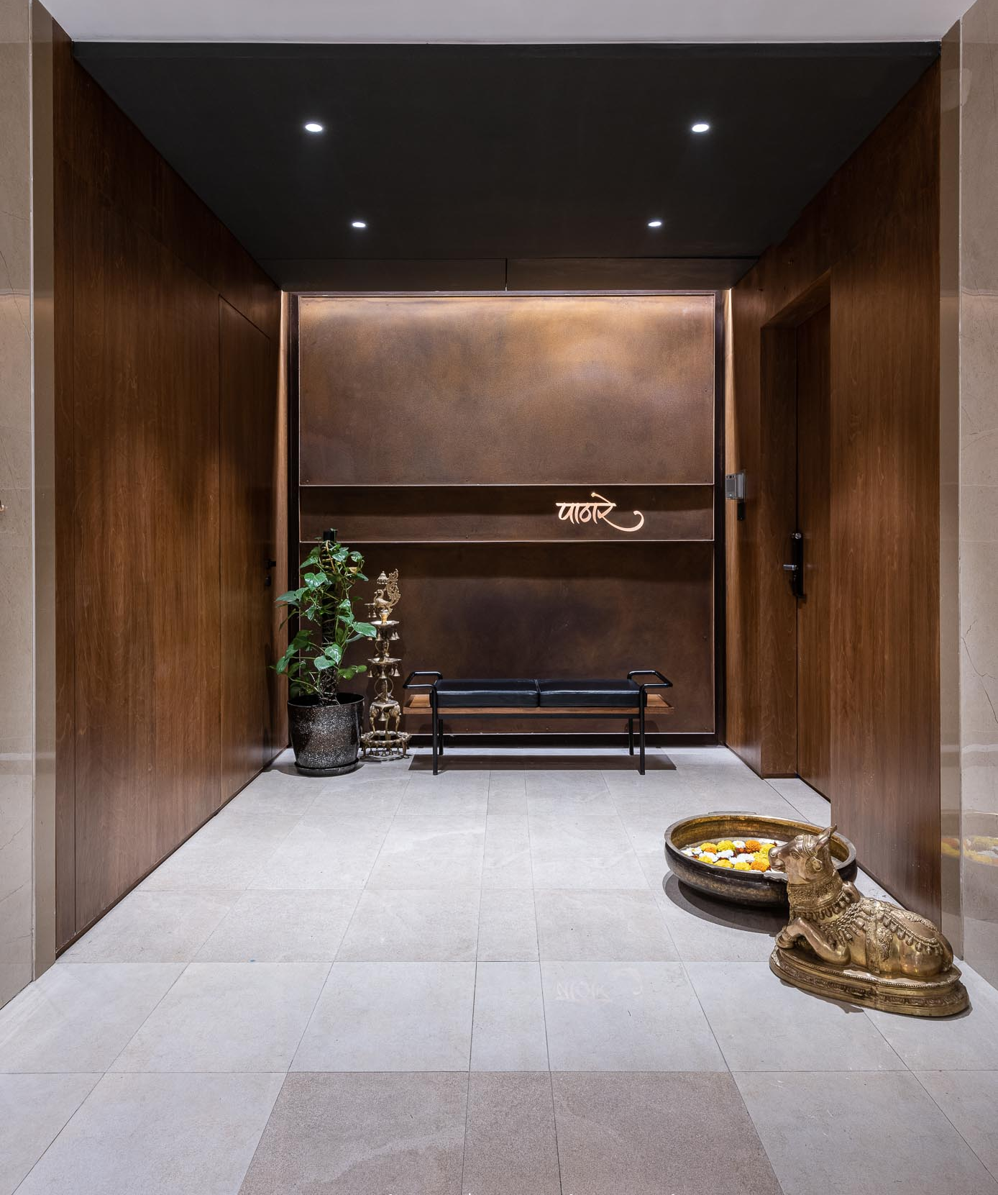
Entrance

Slide 12
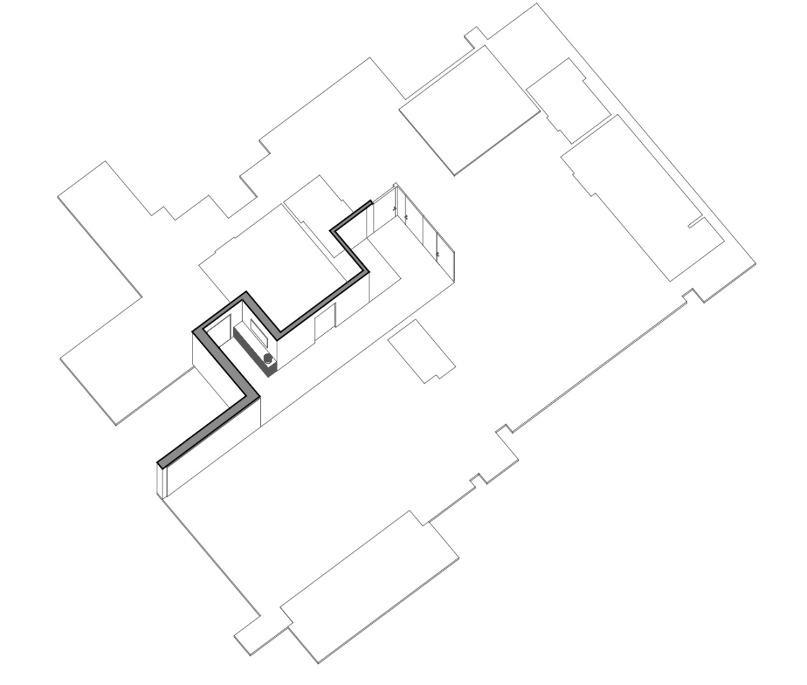
ENTRANCE FOYER

Slide 13
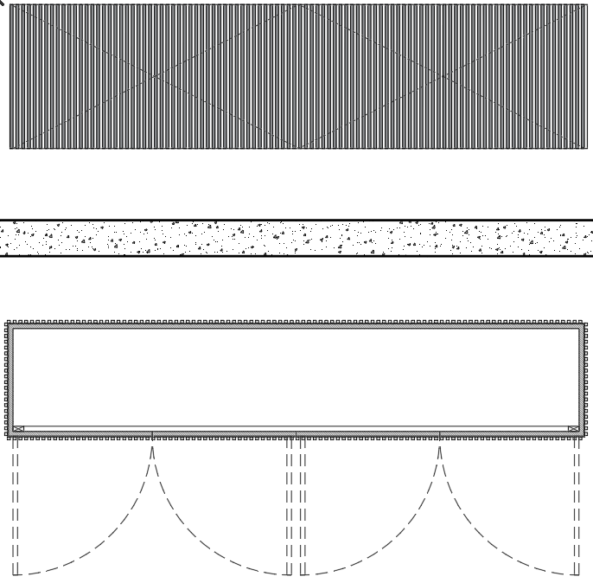
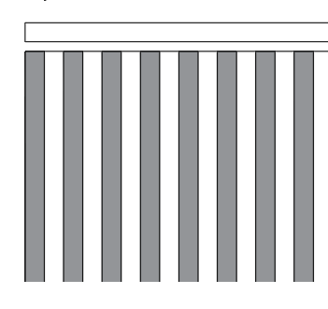
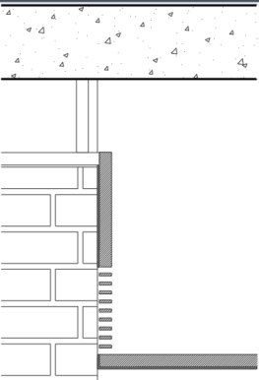
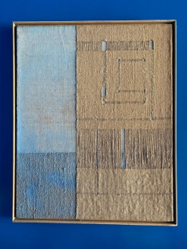
Entrance Foyer:
The entrance lobby is part of the central theme of the house, ‘The Blue Scoop’. The entire volume here is rendered in a single tone of blue color. The idea behind that is to create an illusion of a small chunk of the volume being subtracted from a larger volume that constitutes the overall apartment. The relief here comes in the form of an artwork created using the creative use of jute by known artist Manish Nai.
Slatted MDF sheet 12 x12mm finished in grey PU
A
19mm ply finished in 4mm veneer finished in grey PU
Entrance console :Elevation
19mm ply finished in 4mm veneer finished in grey PU
Slatted MDF sheet
12 x12mm finished in grey PU
B
Entrance console :Plan
12mm back painted
Slatted MDF sheet
12 x12mm finished in grey PU
RCC slab
19mm ply finished in 4mm veneer finished in grey PU
Necessary ply support
Ply backing finished in 4mm veneer finished in back paint
Detail A
AC Vent
Ply backing finished in 4mm veneer finished in back paint
19mm ply finished in 4mm veneer finished in grey PU
AC Vent detail
Slatted MDF sheet
12 x12mm finished in grey PU
Artwork & lighting
Detail B

Slide 14
Entrance Foyer:

Slide 15
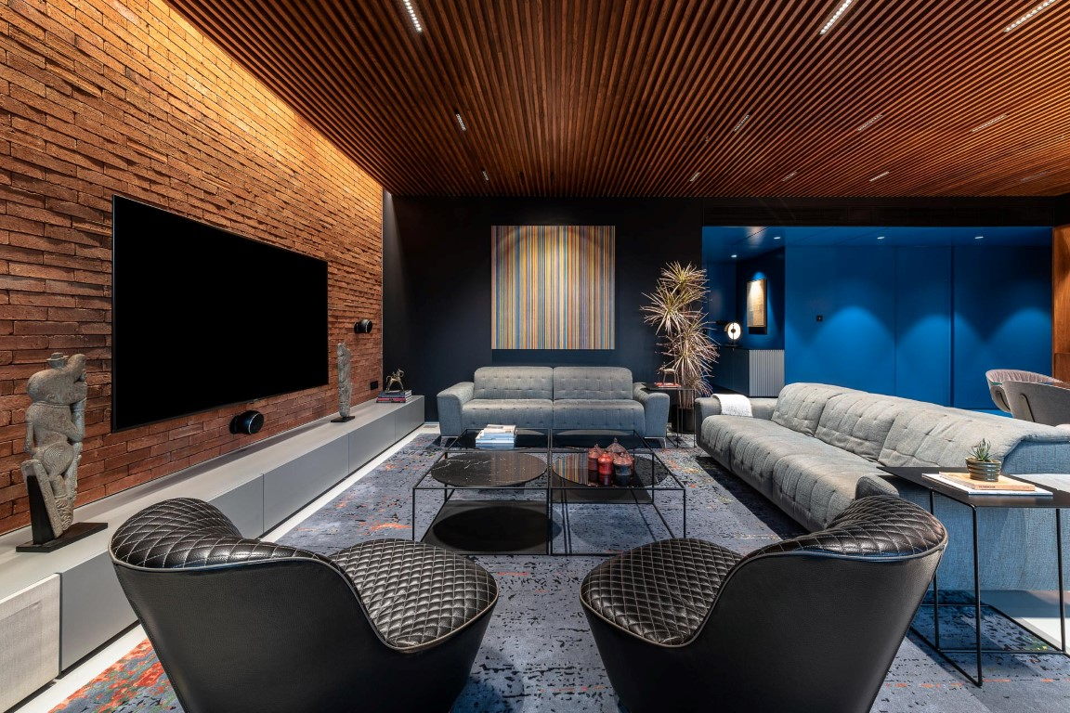
Entrance foyer through living area

Slide 16
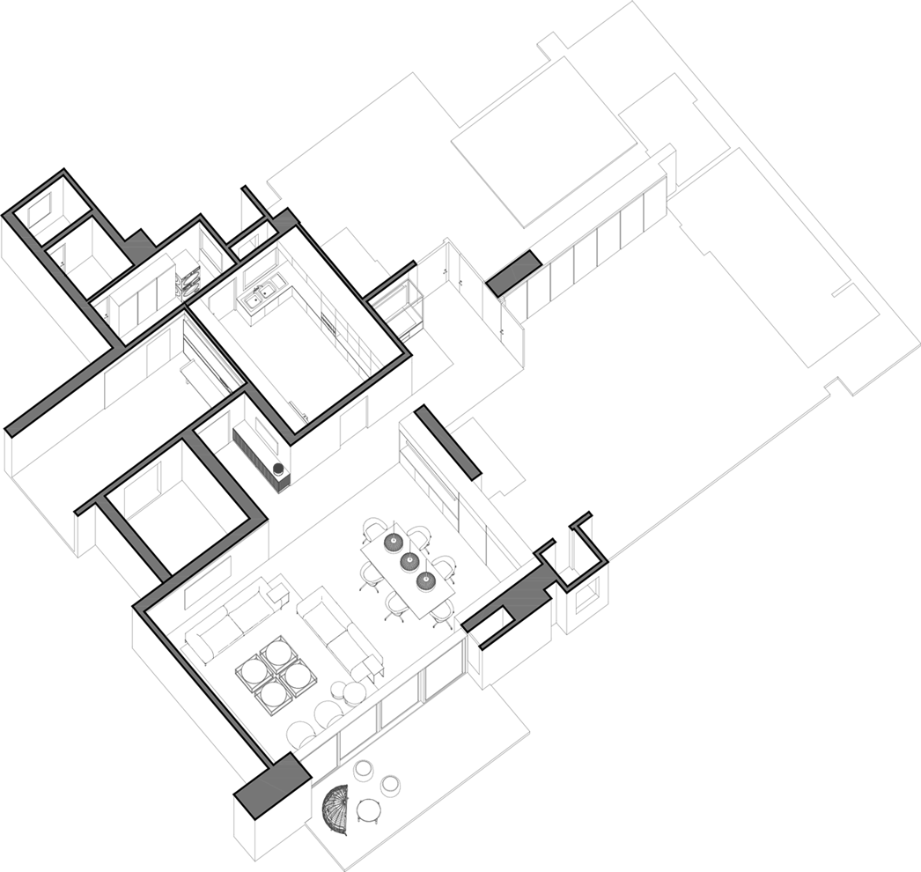
LIVING ROOM

Slide 17
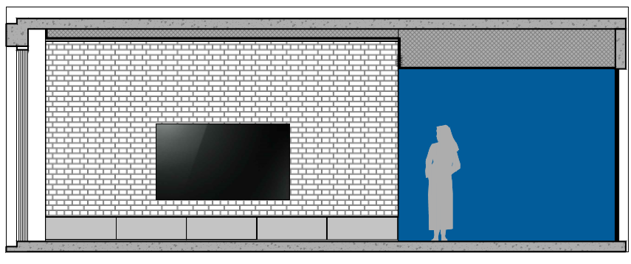
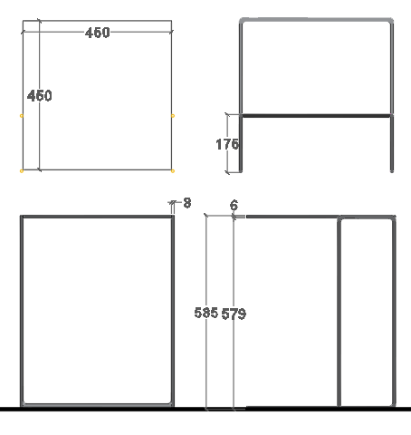
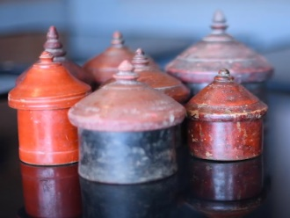
Living room:
The Living space is flanked by the Blue scoop that gets separated by a razor-sharp line. The palette of this space consists of Godhra Bricks, oak wood slatted ceiling, stained birch plywood, concrete slurry floor, and a certain amount of Matt black wall surfaces. There is a deliberate attempt to make the lights part of the slatted profile of the ceiling in a way that hides them from plain sight. There is an ample amount of light that enters from the west side filtering through the balcony overhang. The setup is of a contemporary European furniture offsetted by antique Indian Artefacts. Large hand knotted rug binds the loose furniture around it seamlessly.
Elevation
RCC slab
8mm dia rod finished in matt black powder coating
Curtain pelmet
Grazer light
Ply framework
Wooden slats
Brick cladding
Brick cladding
2mm Aluminium plate
Brick wall
TV console
Antiques and sculptures
Ardex flooring on marble base
6mm thk plate finished in matt black powder coating
Brick wall detail
Side table detail

Slide 18
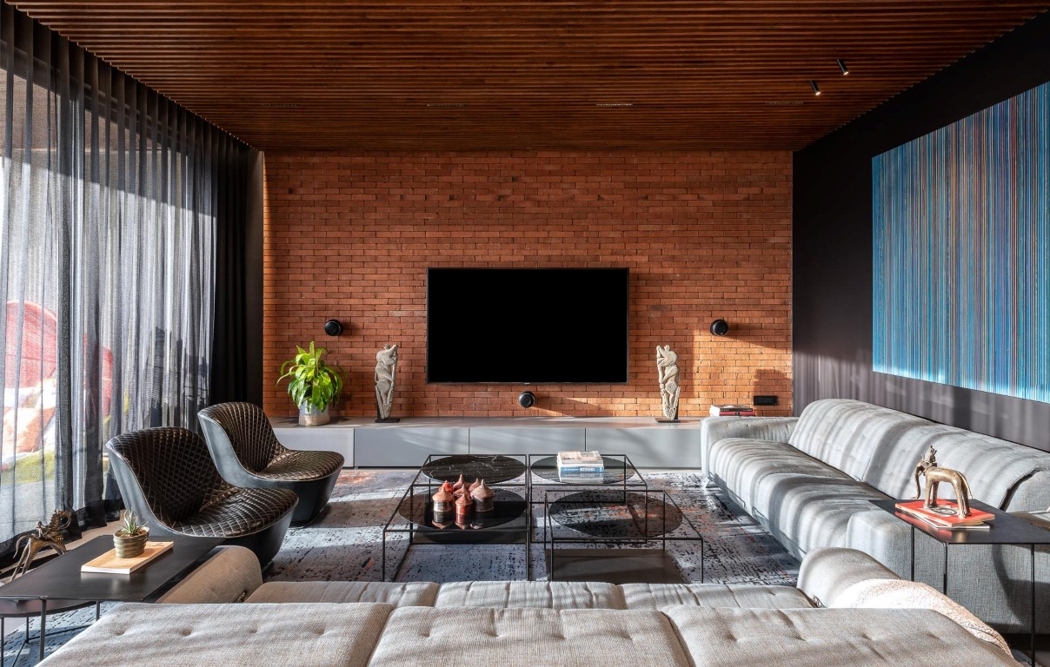
Living Room

Slide 19
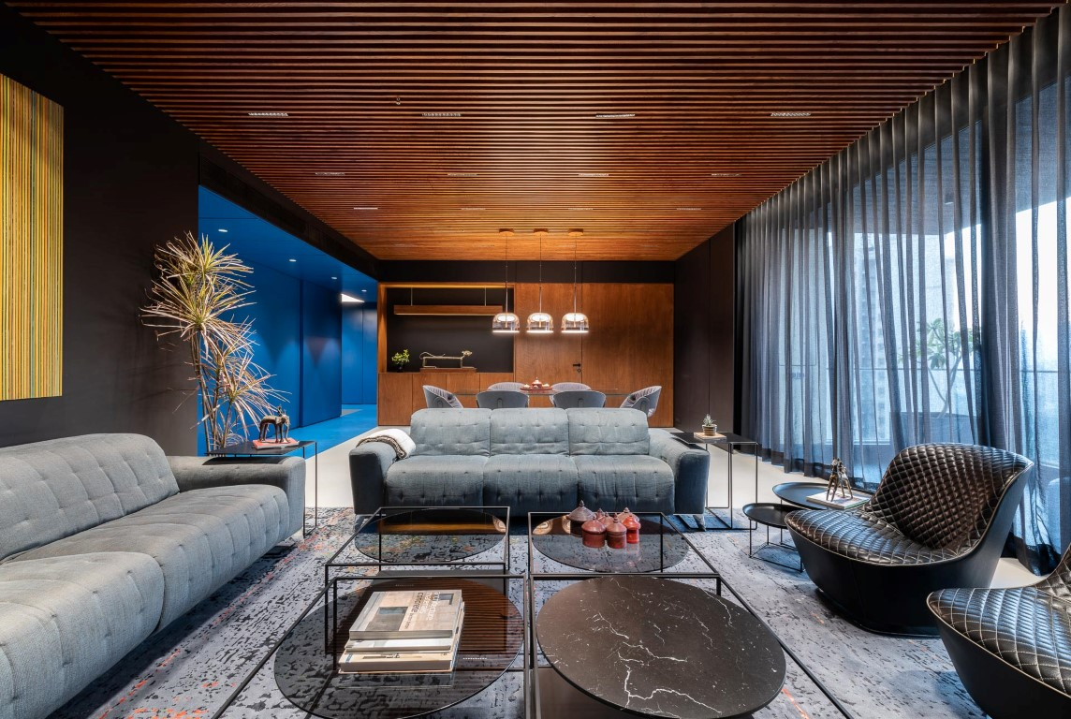
Living Room

Slide 20
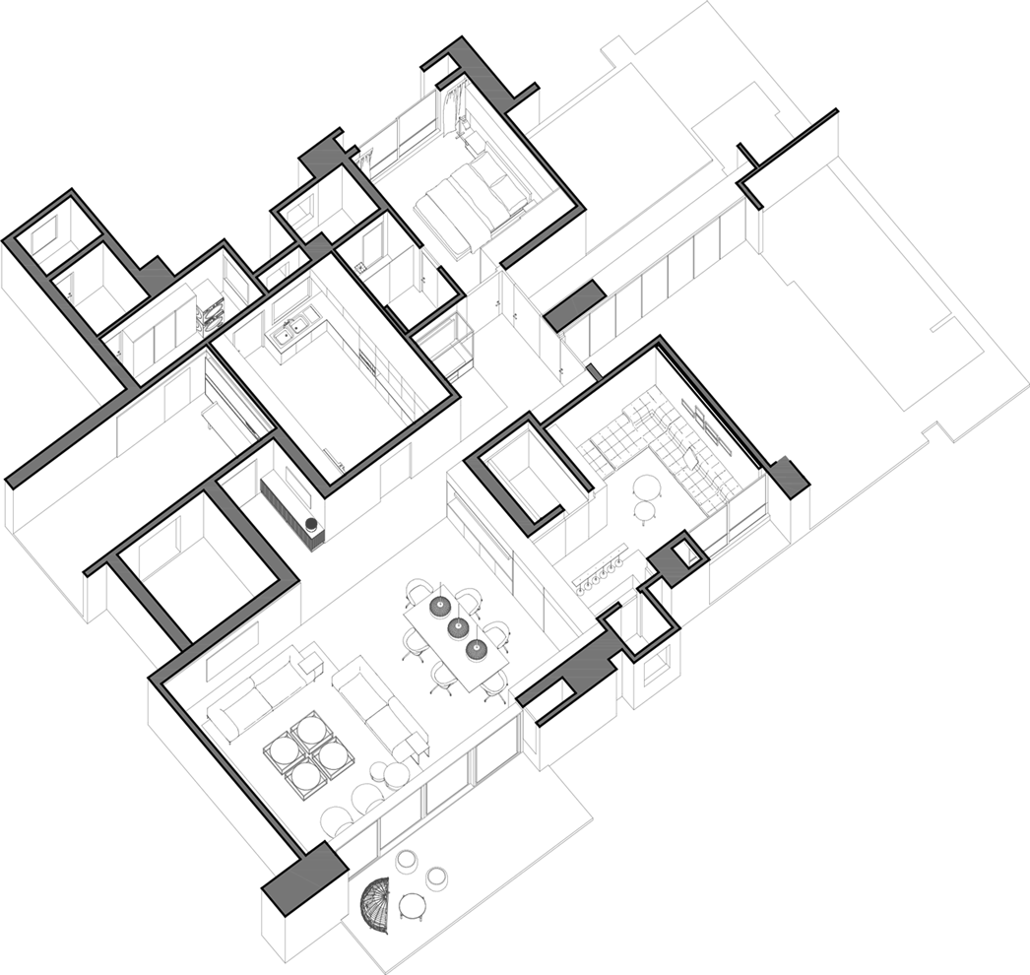
LOUNGE AND BAR COUNTER

Slide 21
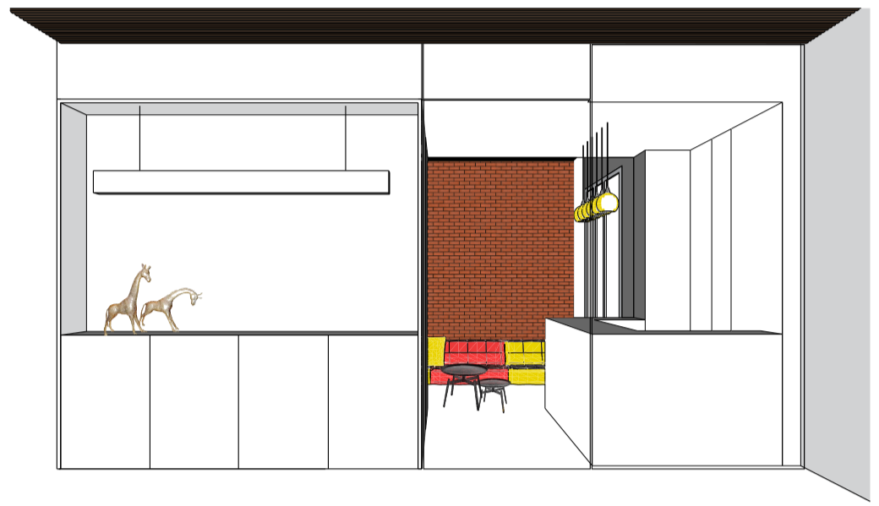
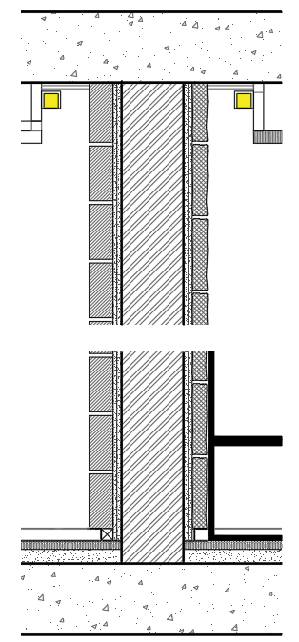
Lounge and bar counter:
The original use of this space was a bedroom with an attached toilet which was accessed from the temple area. During the planning stage, it was connected from the living side and the transitional space was turned into a linear bar. To deem the mood of space casual and relaxed the bricks on the wall were teamed up with busy patterned sofa low in height. The artwork chosen here is also of ruins of vintage cars that add to the rusticity of space.
Elevation
RCC slab
12mm Ply pelmet
Stone cladding
Grazer light
Brick cladding
Wooden Slats
Aluminium skirting
Artworks in contrast with the wall
Brick wall
Ardex flooring on marble
Stone cladding
RCC slab
Brick wall detail : Ceiling
Brick wall detail : Skirting

Slide 22
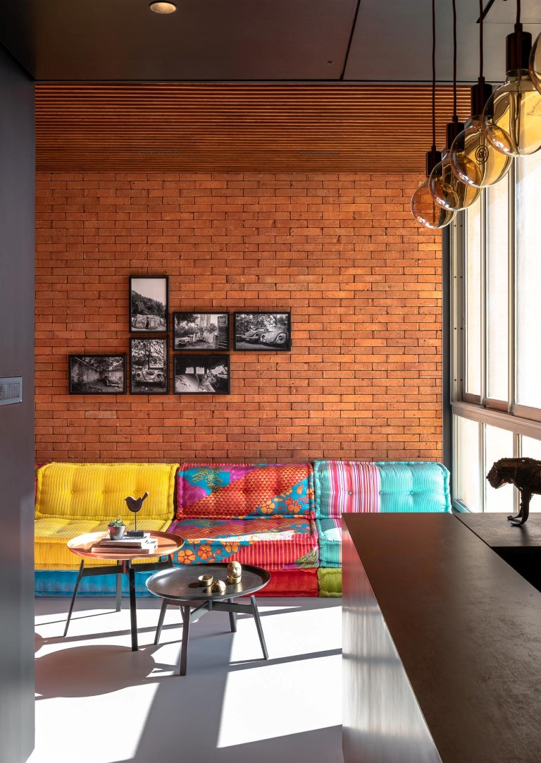
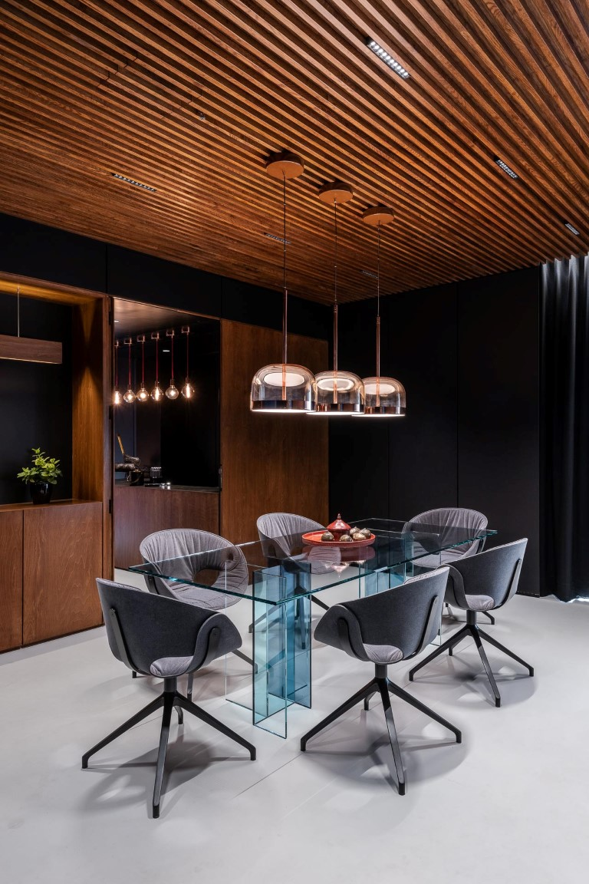
Lounge area
Bar from dining area
BAR COUNTER

Slide 23
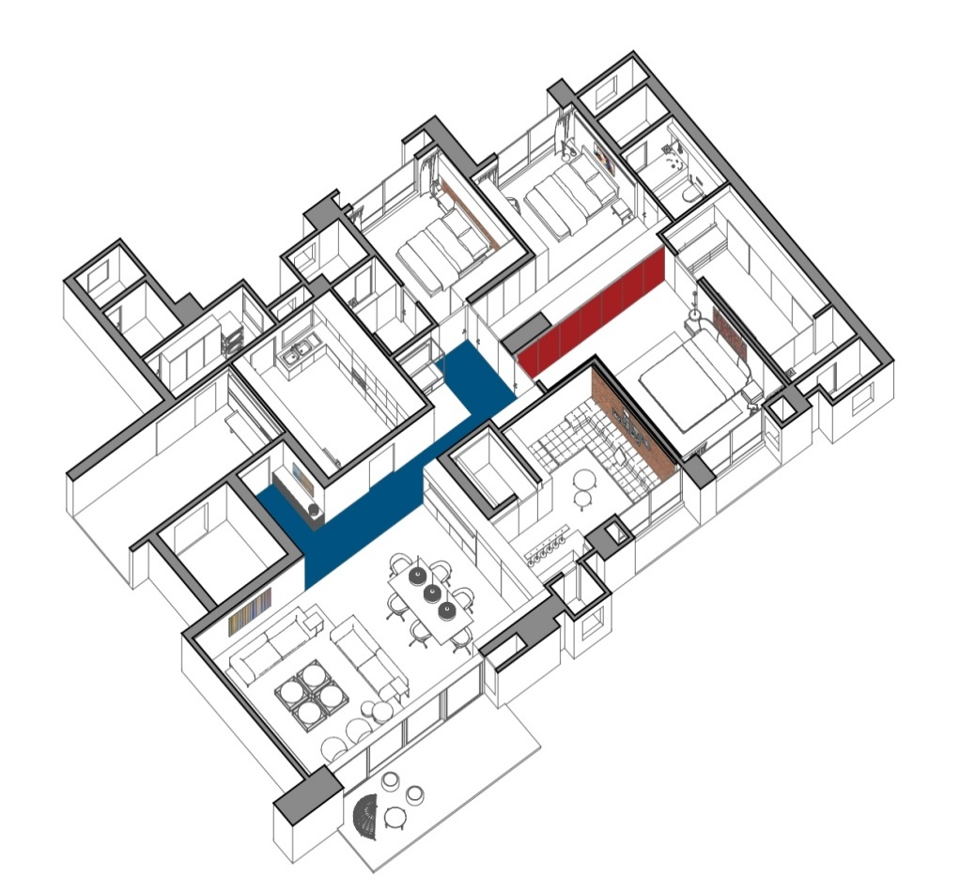
MASTER BEDROOM

Slide 24
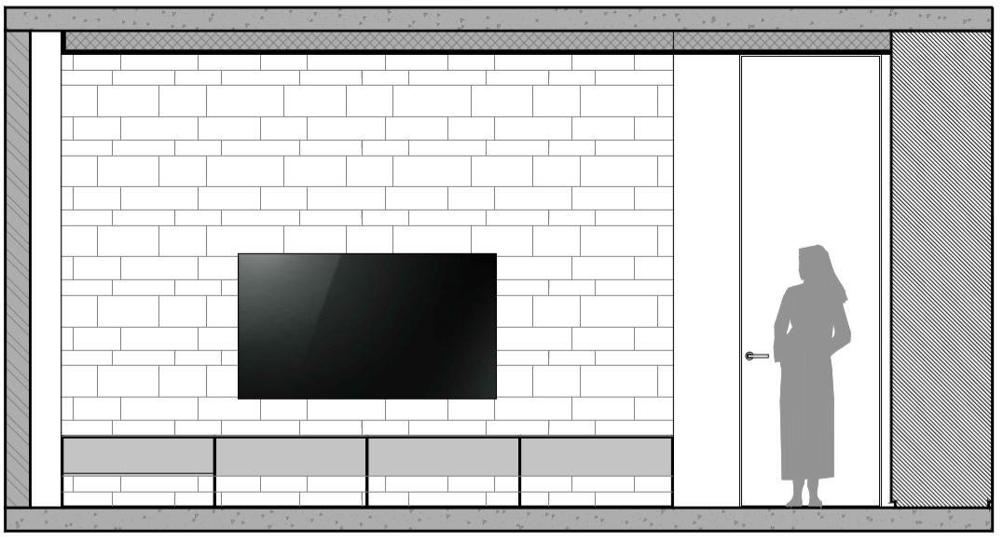
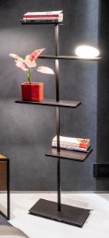
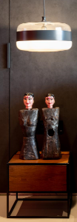
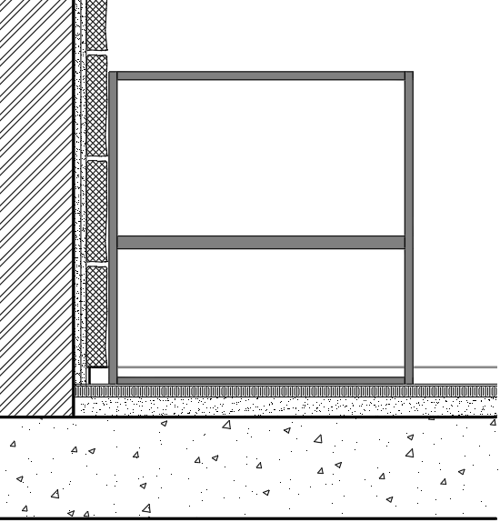
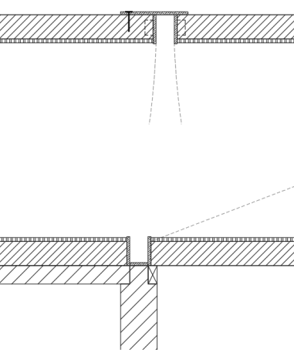
Master Bedroom:
Being in line with the color theory, you are drawn into space by a long row of reflective red glass shuttered wardrobe. Again the opening of the space being on the western side, there is harsh sunlight entering the space. To counter that, the hue of the room was kept neutral in nature. The highlighter wall is done in the local stone cladding that holds the balance of the room. The choice of art here is a contemporary 3D collage that changes in viewpoint while one moves through the space ensuring that each time it’s a unique experience.
Elevation
Aluminium Patti screwed to the door
Handle grip
Stone cladding
4mm back painted glass
TV console
4mm back painted glass
Aluminium skirting
Light weight door made in aluminium box section framing with 6mm ply on both sides
RCC slab
Antiques and lighting.
Stone wall detail
Door shutter detail

Slide 25
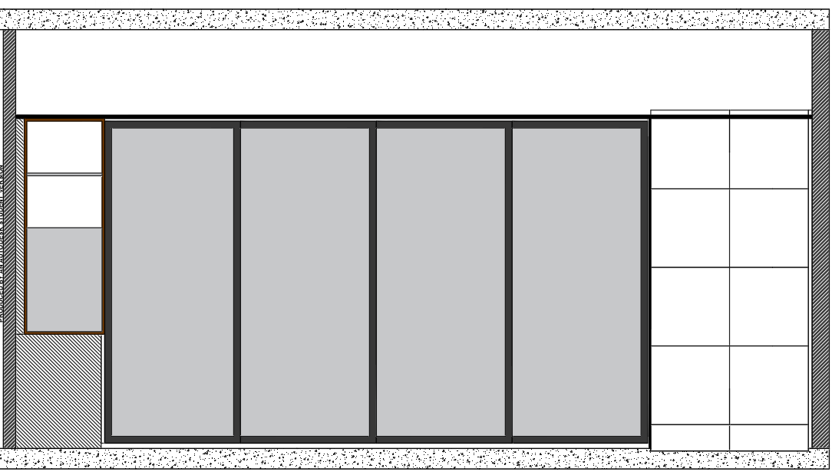
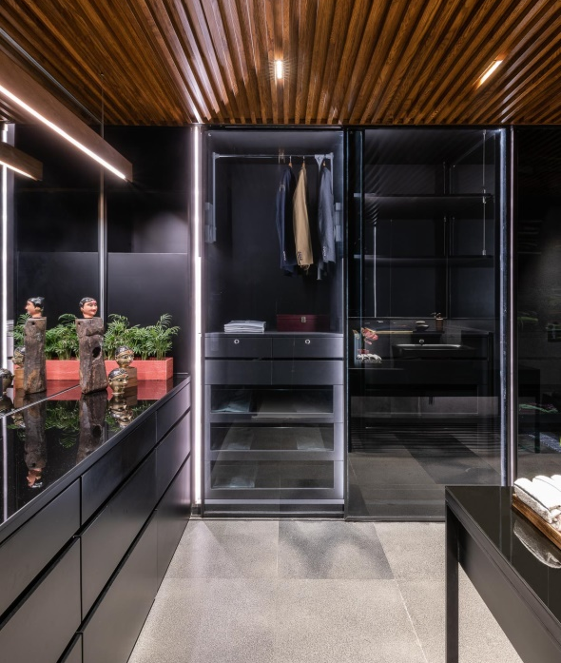
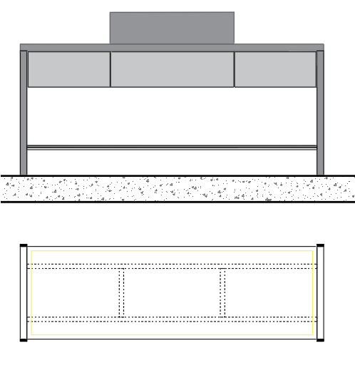
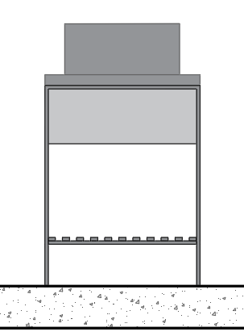
Master Bathroom:
This long space is a combination of walk-in closet and master toilet. The mood of the volume is set to dark. Wardrobes are custom made in black tinted glass, the floor is local Basalt and the ceiling is slatted oak wood. The use of mirrors on the short and long sides in strategic locations achieves infinite reflectivity.
Elevation
Wash basin
Plywood top with 4mm thk polished veneer
drawer
fixed
drawer
Shelf made of metal sheet cladding on framing finished in black powder coating
Elevation
Elevation
Metal framework
Plan

Slide 26
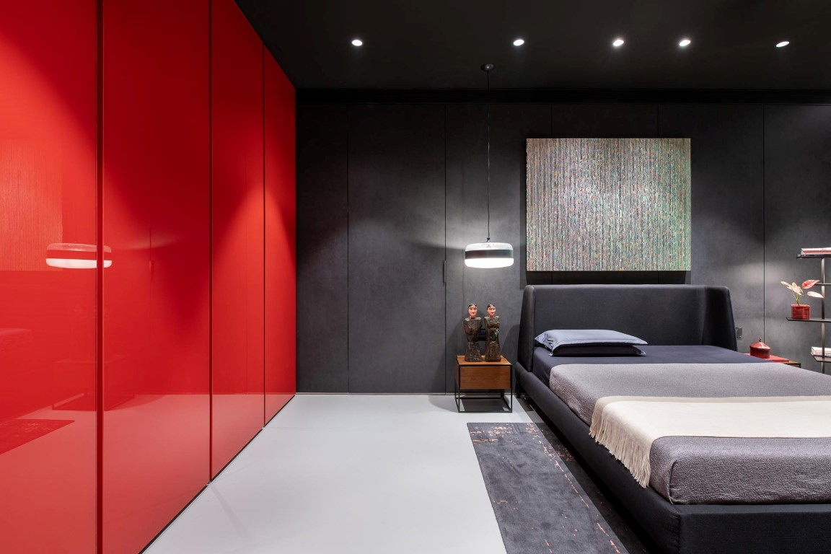
Master bedroom

Slide 27
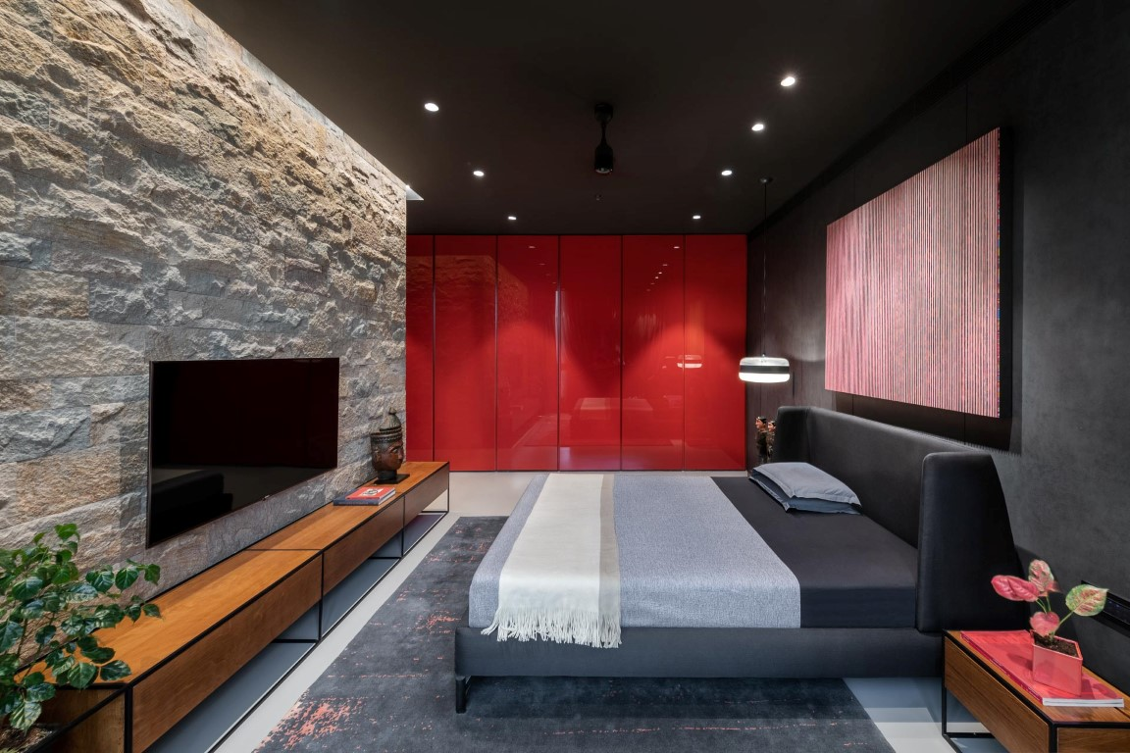
Master bedroom

Slide 28
DAUGHTER’S ROOM

Slide 29
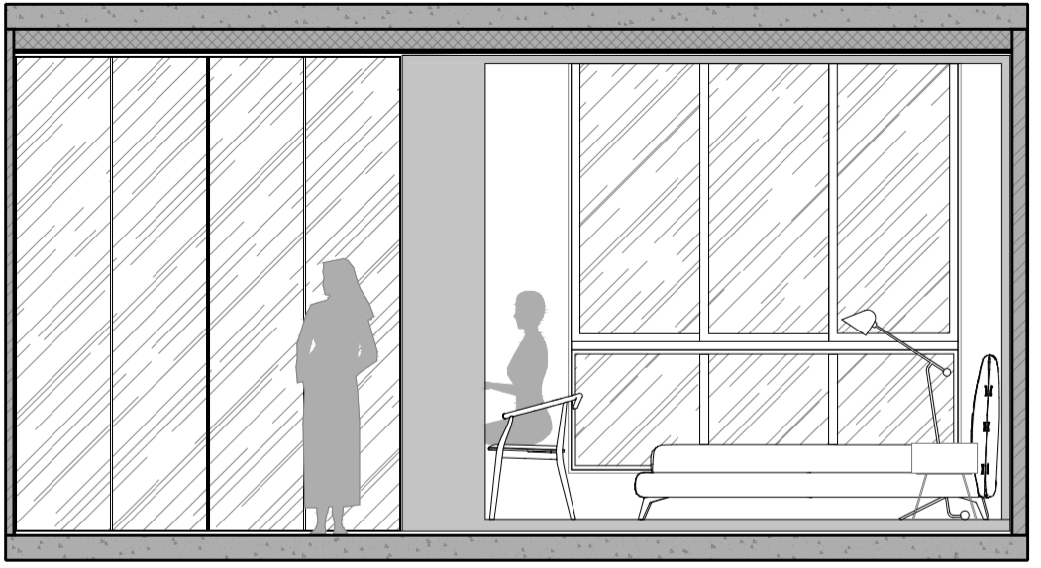
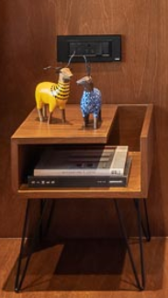
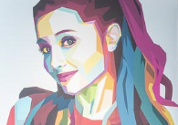
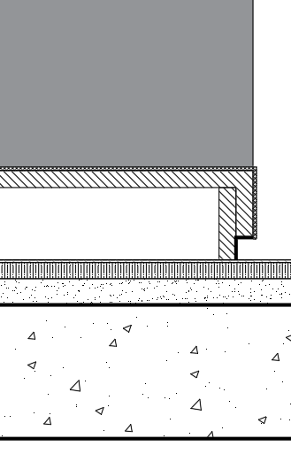
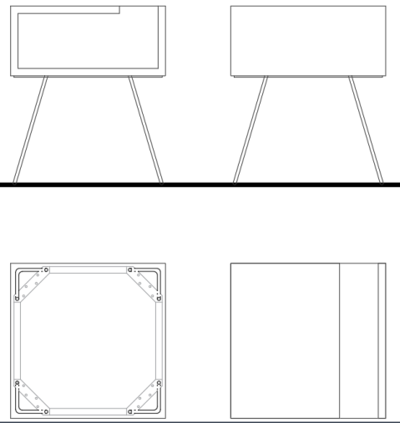
Daughters Bedroom:
Here, you are brought into the space flanked by a long row of wardrobe on one side in a shade of pink back painted glass and mirrored shutters on the other. The space is divided into two parts by use of a stepped-up wrap around volume made up of stained birch plywood around the bed and the adjoining study on one side. The other side of the space is made of the concrete floor with the ceiling height wardrobes. The arrangement of the room is minimal by choice to emphasize the volumetric moves.
Elevation
Polished plywood table top
8mm dia solid rod finished in black powdercoating
Birch ply
Ply backing
Aluminium Skirting
Elevation A
Elevation B
Ardex flooring on marble subfloor
Stone cladding
Raised platform detail
Plan-Metal framework
Plan

Slide 30
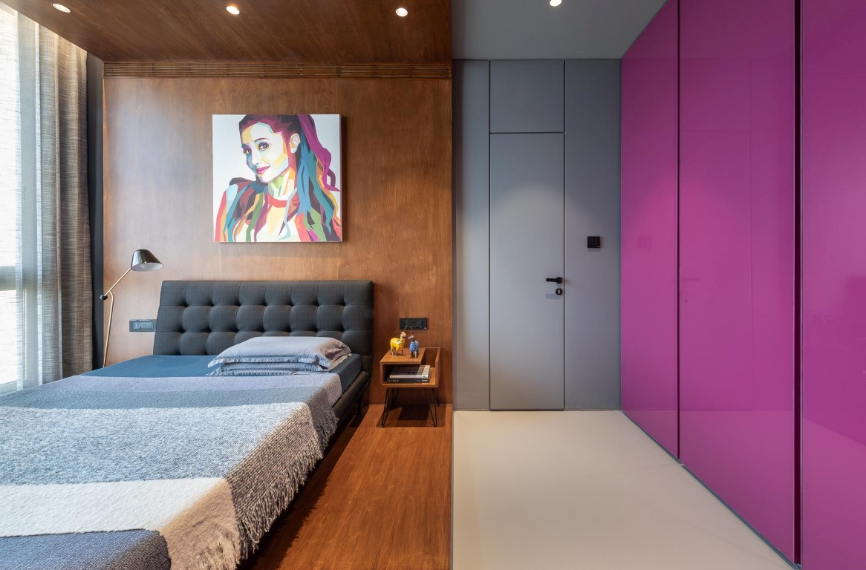
Daughters bedroom

Slide 31
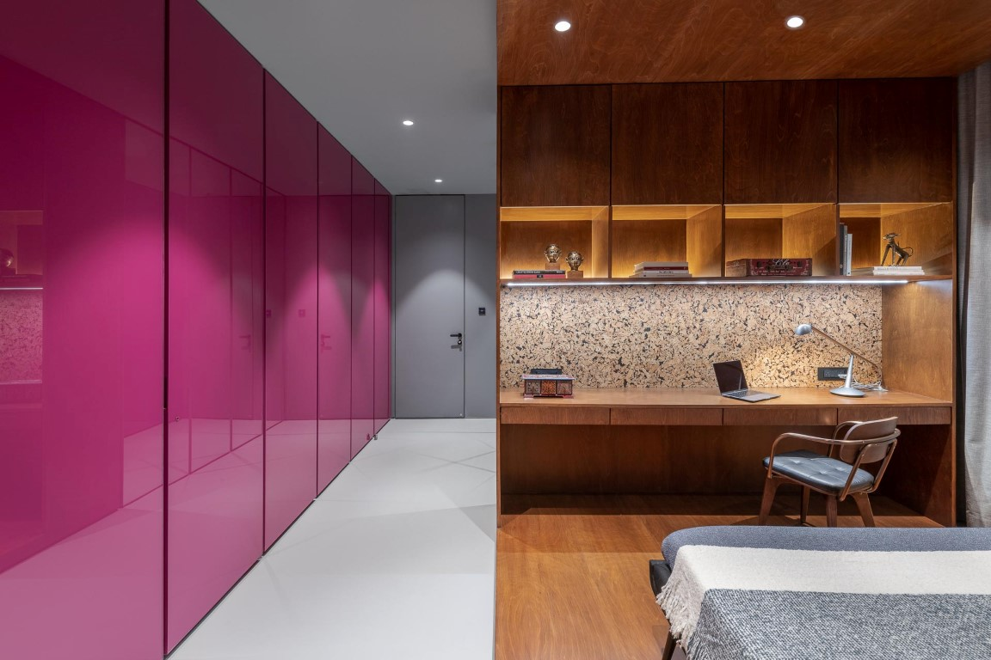
Daughters bedroom

Slide 32
GUEST BEDROOM

Slide 33
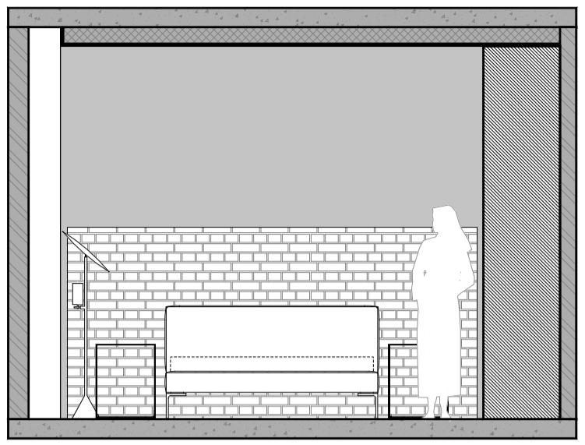
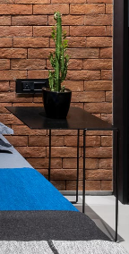
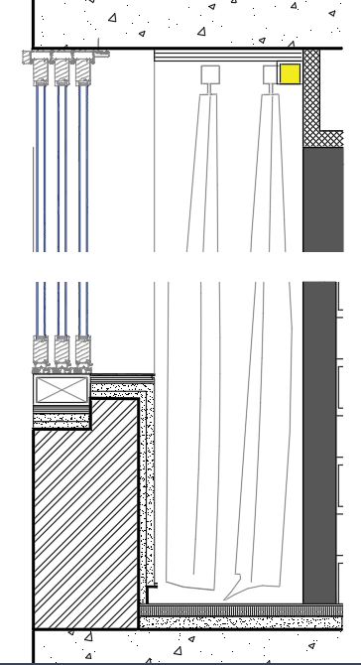
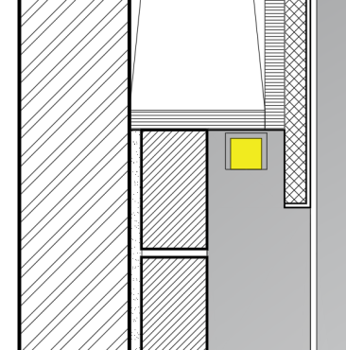
Guest Bedroom:
This is a fairly small space compared to the others. Being consistent with the other spaces the mood of this room was set to be dark. The walls and the wardrobes go into the greyscale while the bed head-board wall breaks the monotony by use of bricks in part.
A
Elevation
RCC Slab
Ply pelmet
Brick wall
Grazer light
Ply backing
Curtains
Veneer finished
in black paint
Sliding window
Grazer light
Brick wall cladding
Aluminium plate
Ply Backing
Plaster finished in paint
Aluminium skirting
Lamp
Side table
Detail A

Slide 34
Guest bedroom

Slide 35
Guest bedroom

