Slide 2
make it HUMAN.

Slide 3
keep it LIGHT.

Slide 4
make it STIMULATING.

Slide 5
The Club lounge | Interior design
Herzliya July 2019

Slide 6
Design concept

Slide 7
The best room in the Hotel!

Slide 8
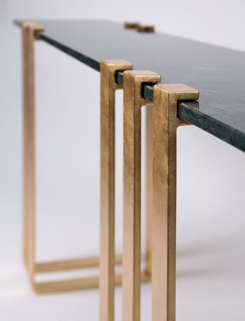
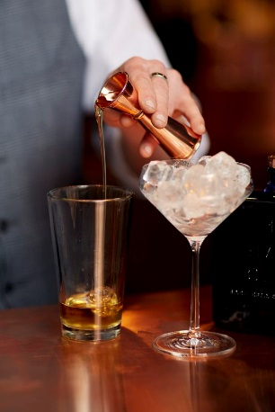
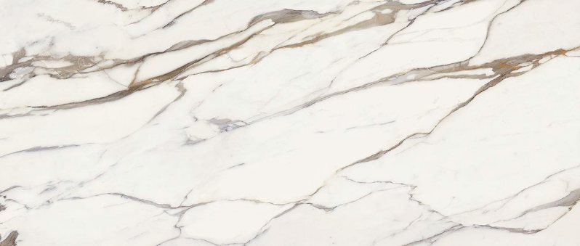
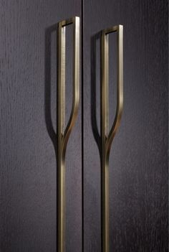
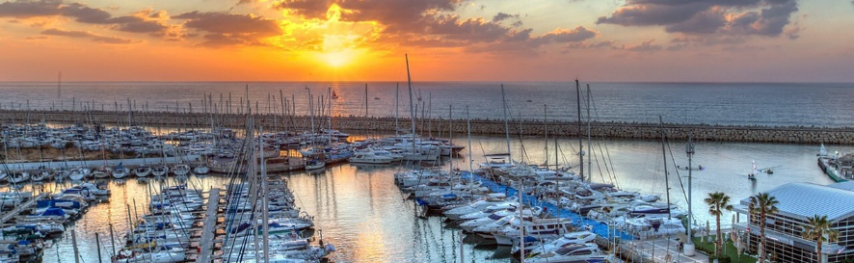
The Best Room
Best service
Starting the day and the evening
Scenery
Exclusive
Details

Slide 9
Inspirations

Slide 11
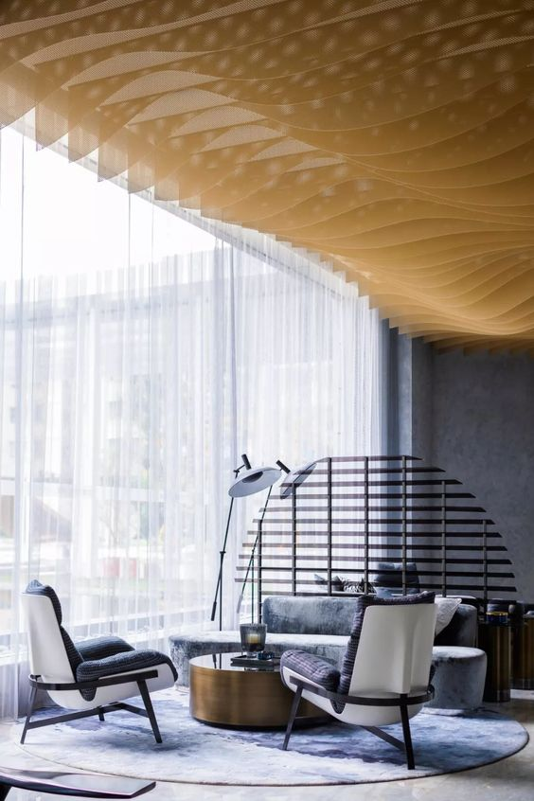
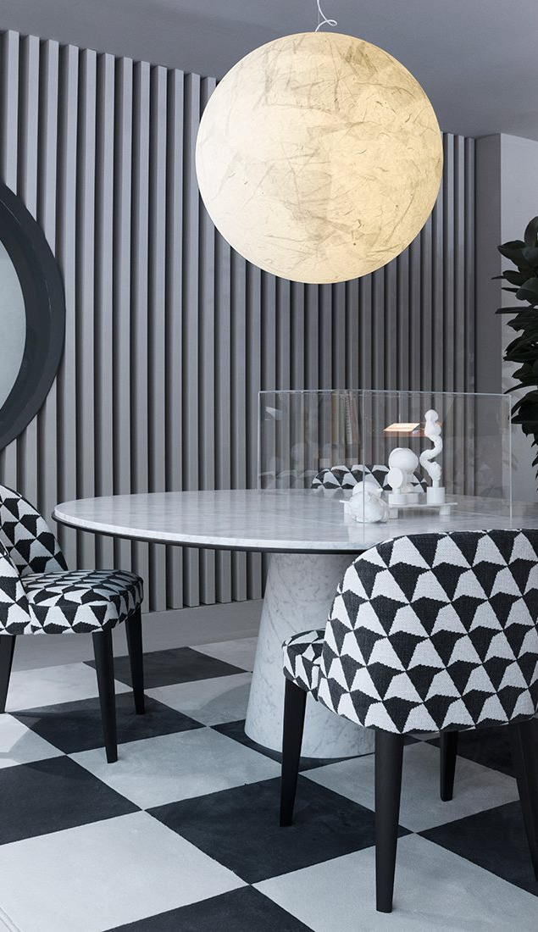
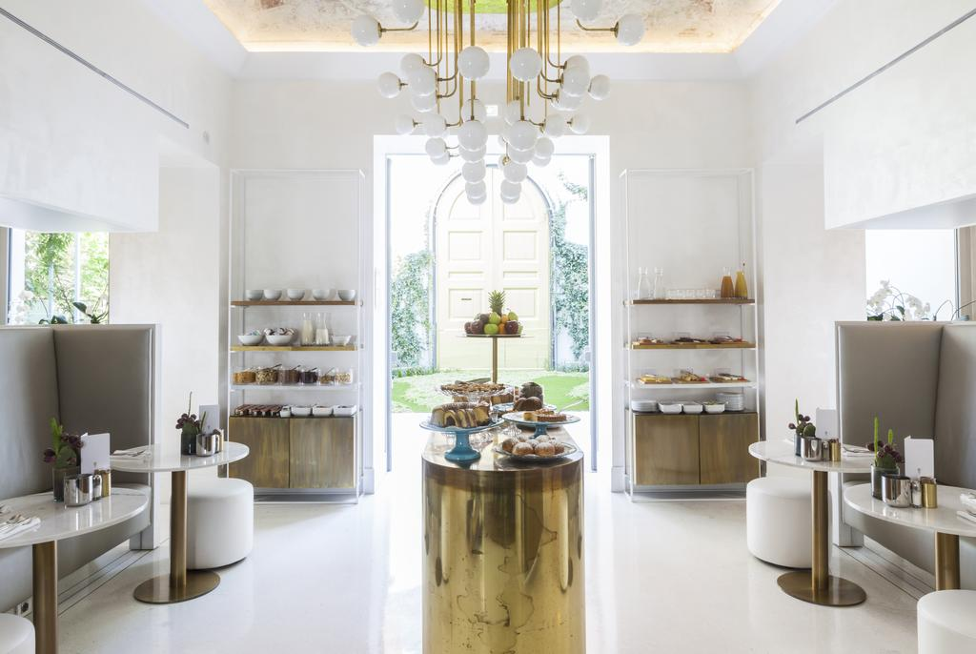

Slide 12
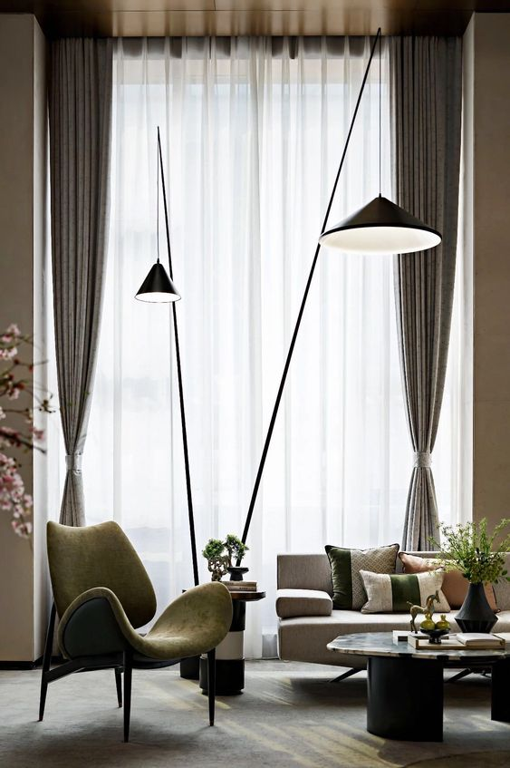

Slide 13
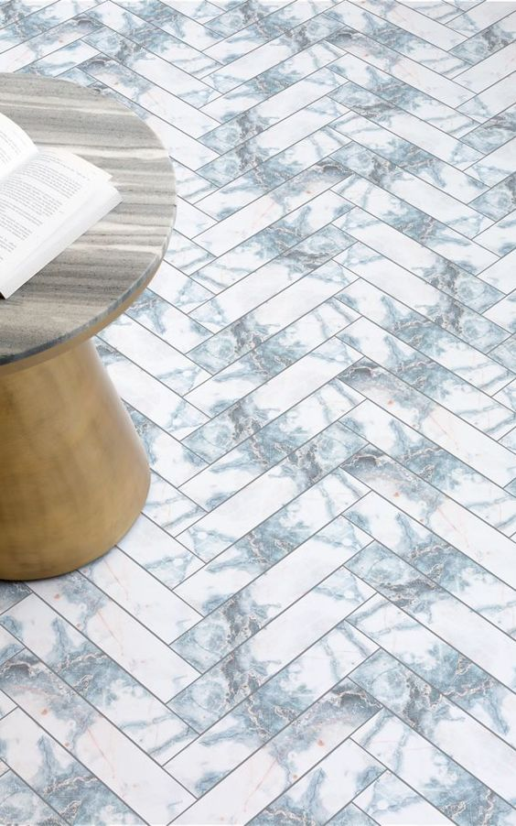
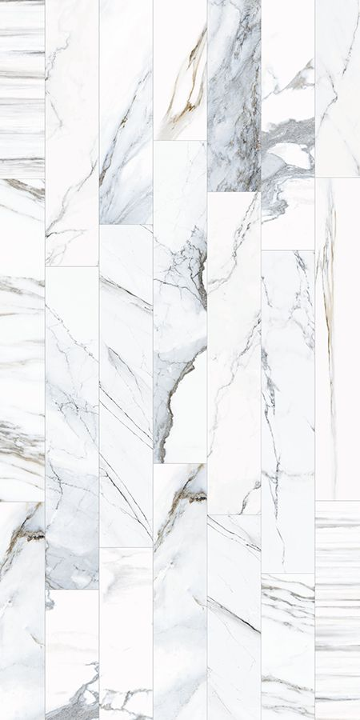
WallS & Floor cladding

Slide 14
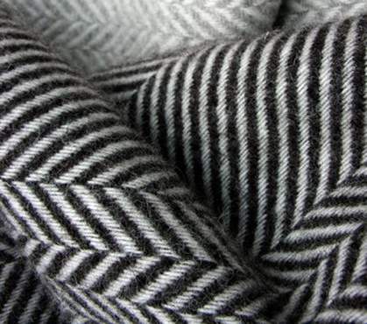
Textile & Finishing materials

Slide 15
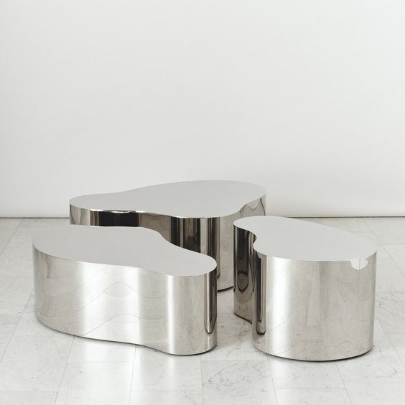
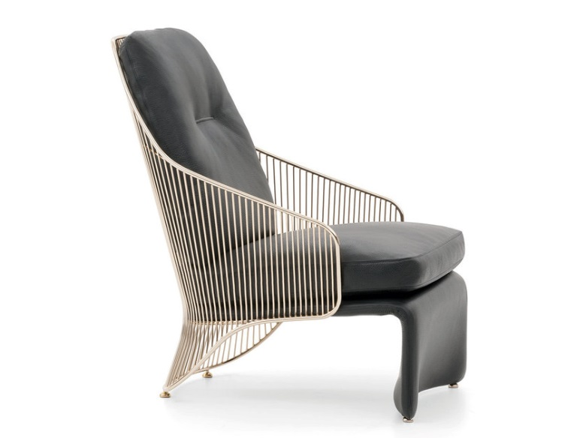
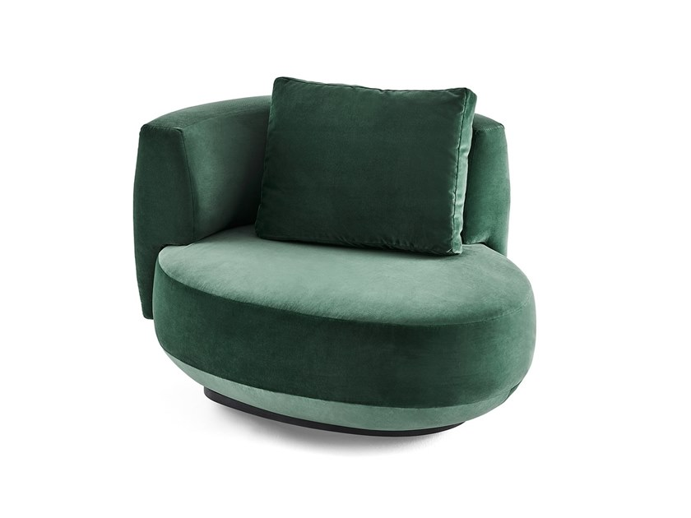
Stainless Steel Free Form Low Table
By Karl Springer
Guscio Sofa
By Divano
Vizio
Living Divani
Gallotti&Radice
Armchairs
AUDREY
194 9
tables
Cassina
colette
Armchairs
Minotti

Slide 16
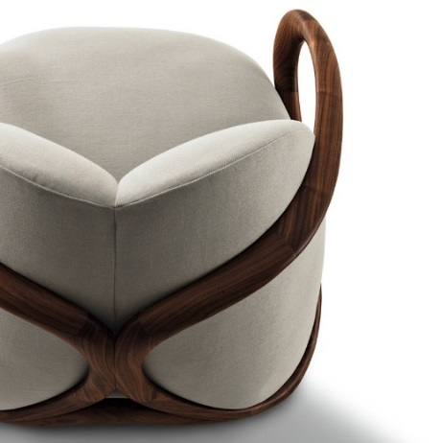
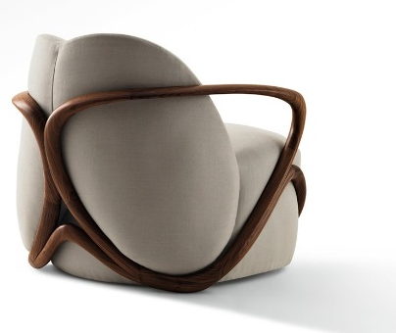
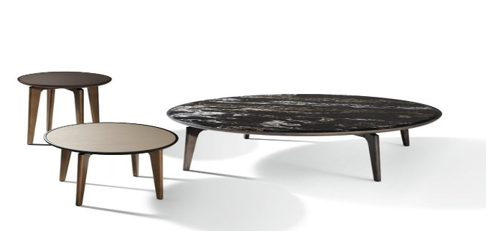
Leon
Sofa
Baxter
Islands
Livingdivani
HUG
Armchair
GIORGETTI
BLEND Round-coffee tables
GIORGETTI

Slide 17
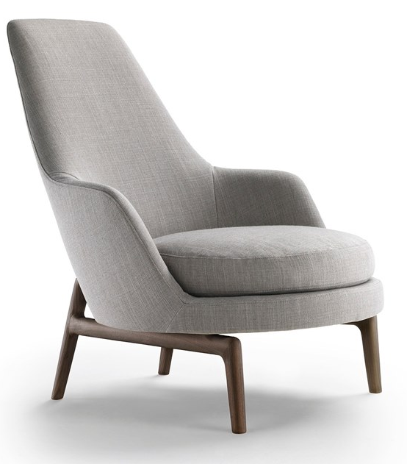
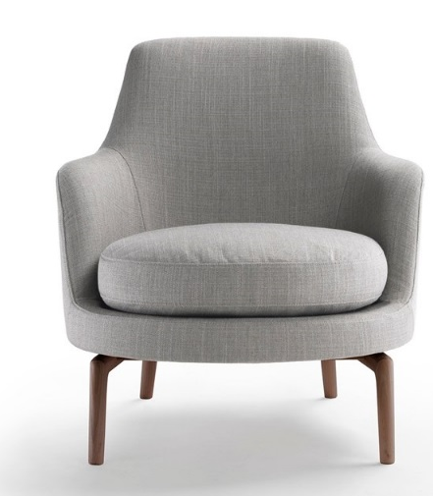
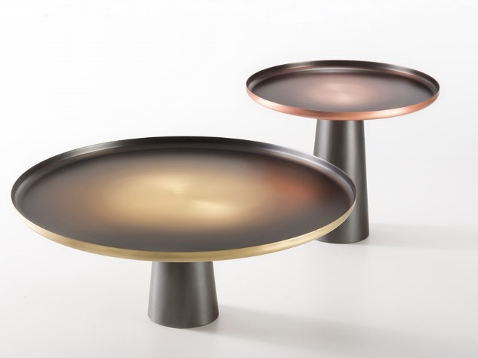
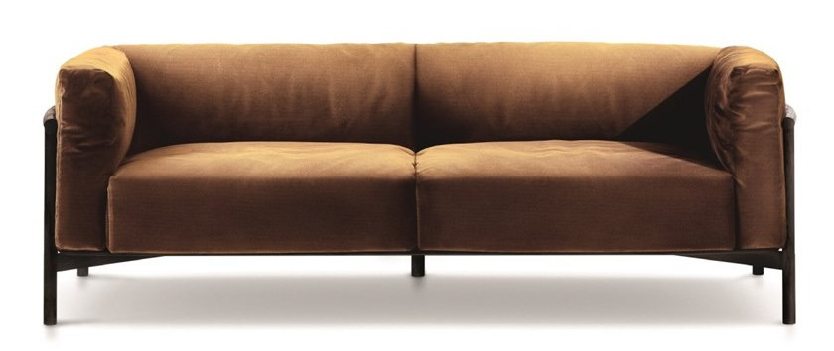
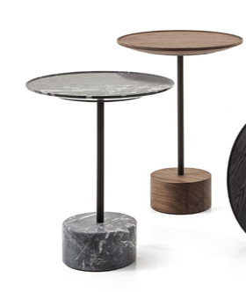
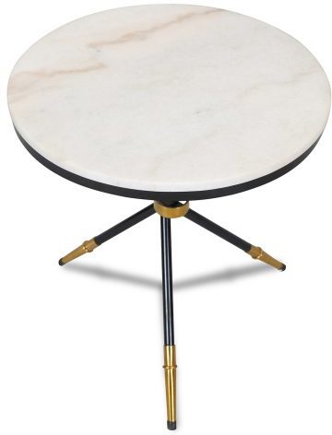
LEDA Armchair
FLEXRORM
SUNRISE SUNSET coffee tables
by DE-CASTELLI
Side tables
by CASSINA
TAIK Sofa
Lema
Leslie "Dining"
CHAIRS
minotti

Slide 18
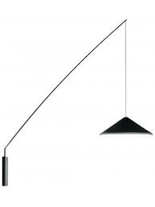
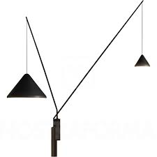
MOONS chandelier
by Nir Meiri Srudio
MOONS FLOOR LAMP
BELLS FLOOR LAMP
NEW DESIGN
By Nir Meiri Srudio
North Wall
By Vibia

Slide 19
Plans

Slide 20
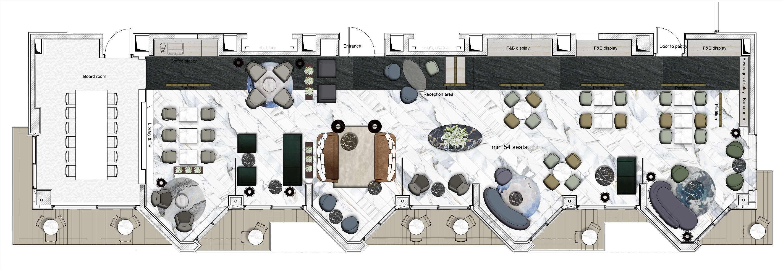
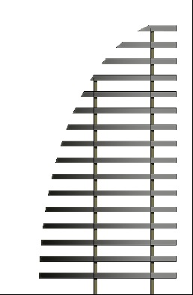
General Layout plan
Option 1
Partition

Slide 21
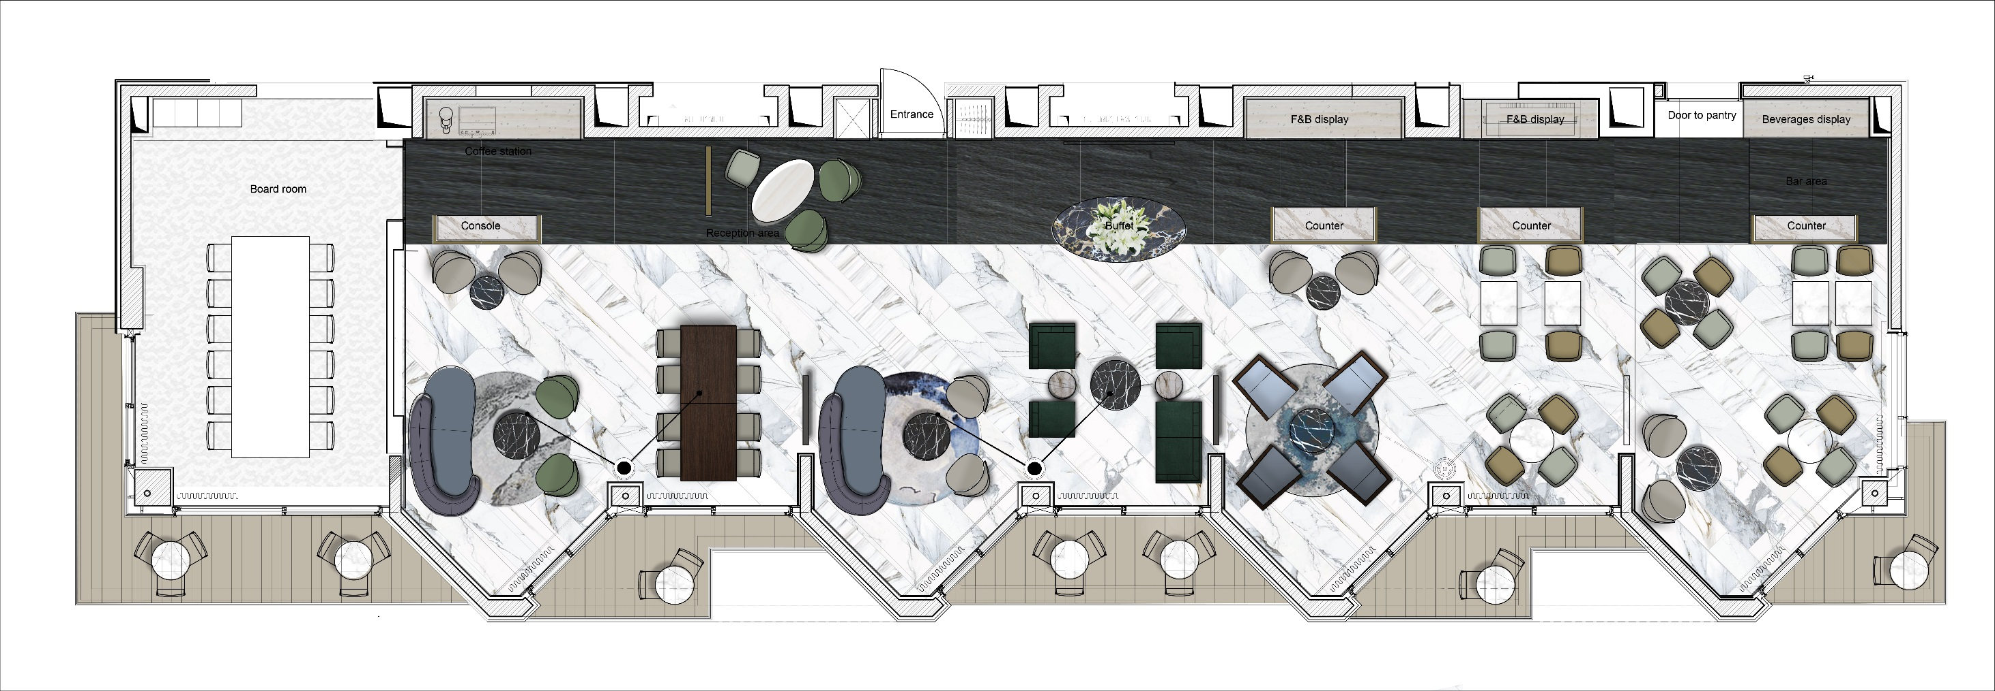
General Layout plan
Option 2
Light fixture
Partition

Slide 22
Ceiling concept

Slide 23
The Club lounge | Interior design
Herzliya July 2019

